Slide 1

Impact of Global Chip shortage on Market
BAIM635 Capstone Project

Slide 2
IntroDuction
Notes:
The global semiconductor shortage that began in early 2020 disrupted multiple industries and reshaped market dynamics. Sectors heavily dependent on chips—such as consumer electronics, automotive manufacturing, and telecommunications—experienced production delays, higher costs, and supply-chain bottlenecks. Simultaneously, emerging technology sectors including artificial intelligence and clean energy were indirectly affected due to heightened demand for computational hardware. This project analyzes how these disruptions influenced financial performance across sectors between 2015 and 2025, focusing on both broad indices and company-level representatives.

Slide 3
Data
Data Range: 2015–2025 Phases Defined:
Phase 1: Pre-shortage (2015–2019)
Phase 2: Global chip shortage (2020–2022)
Phase 3: Post-acute & tariff tensions (2023–2025)

Slide 4
Data
Sector Representatives: Directly Impacted:
Apple (AAPL) – Consumer Electronics
Intel (INTC) – Semiconductor Manufacturing
General Motors (GM) – Automotive
Broadcom (AVGO) – Telecommunications
Emerging Tech Sectors:
NVIDIA (NVDA) – GPU/AI
Qualcomm (QCOM) – Wireless/5G
First Solar (FSLR) – Clean Energy
Indices:
SOXX – Semiconductor ETF
SPY – S&P500 ETF

Slide 5
EDA

Slide 6
SQL Query & Data Extraction Summary
Extracted minute-level data for each ticker from the polygon_1m_bars schema.
Selected the last 1-minute closing price (between 09:30–16:00) for each trading day.
Removed weekends and all NYSE holidays (2015–2025).
Consolidated final dataset included daily closing prices for all selected tickers.
Resulted in a complete day-level time series for indices and sector representatives, enabling consistent comparisons.

Slide 7
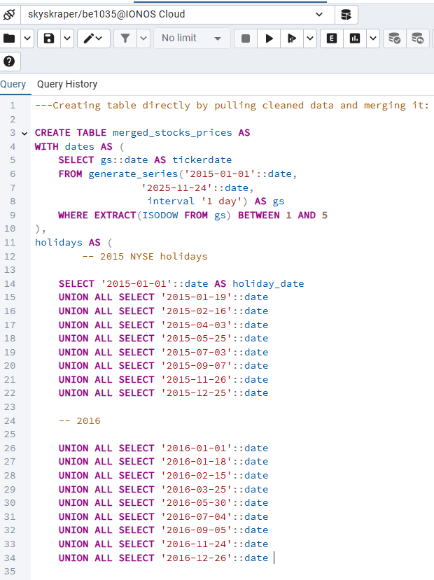
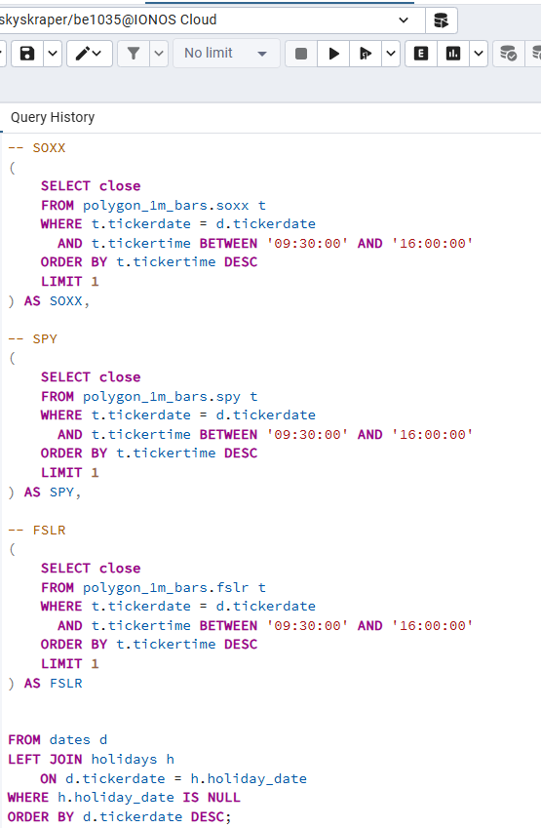
SQL Query & Data Extraction Summary

Slide 8
ANALYSIS Methods
1. Returns Comparison Measured how sector performance changed across the three phases.
2. Volatility Analysis Standard deviation of daily returns to evaluate sensitivity to supply-chain stress.
3. Correlation Analysis Assessed co-movement between SOXX, SPY, and sector representatives.
4. Association Mining Estimated how strongly each stock's returns depended on SOXX.
5. Structural Break Test (Chow Test) Checked whether market behavior changed significantly at known disruption points (2020 and 2023).
6. Clustering (K-means) Grouped companies based on phase-wise returns and volatility.

Slide 9
Results

Slide 10
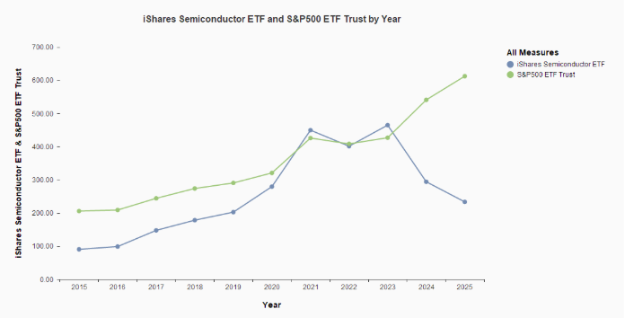
Line chart (INDICES)

Slide 11
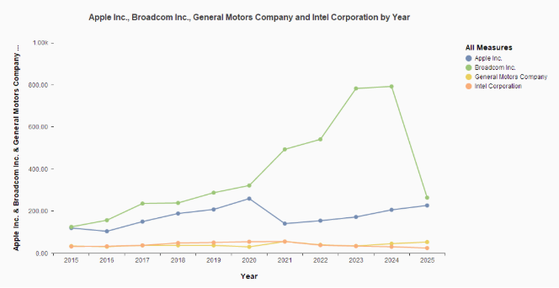
Line chart (Sectors)

Slide 12
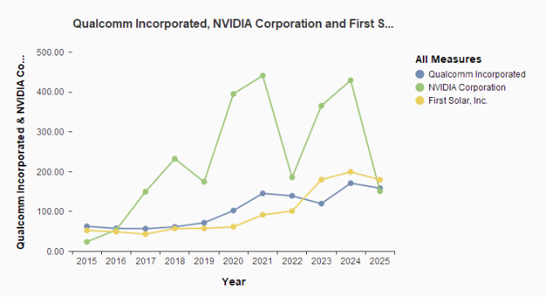
Line chart (Sectors)

Slide 13
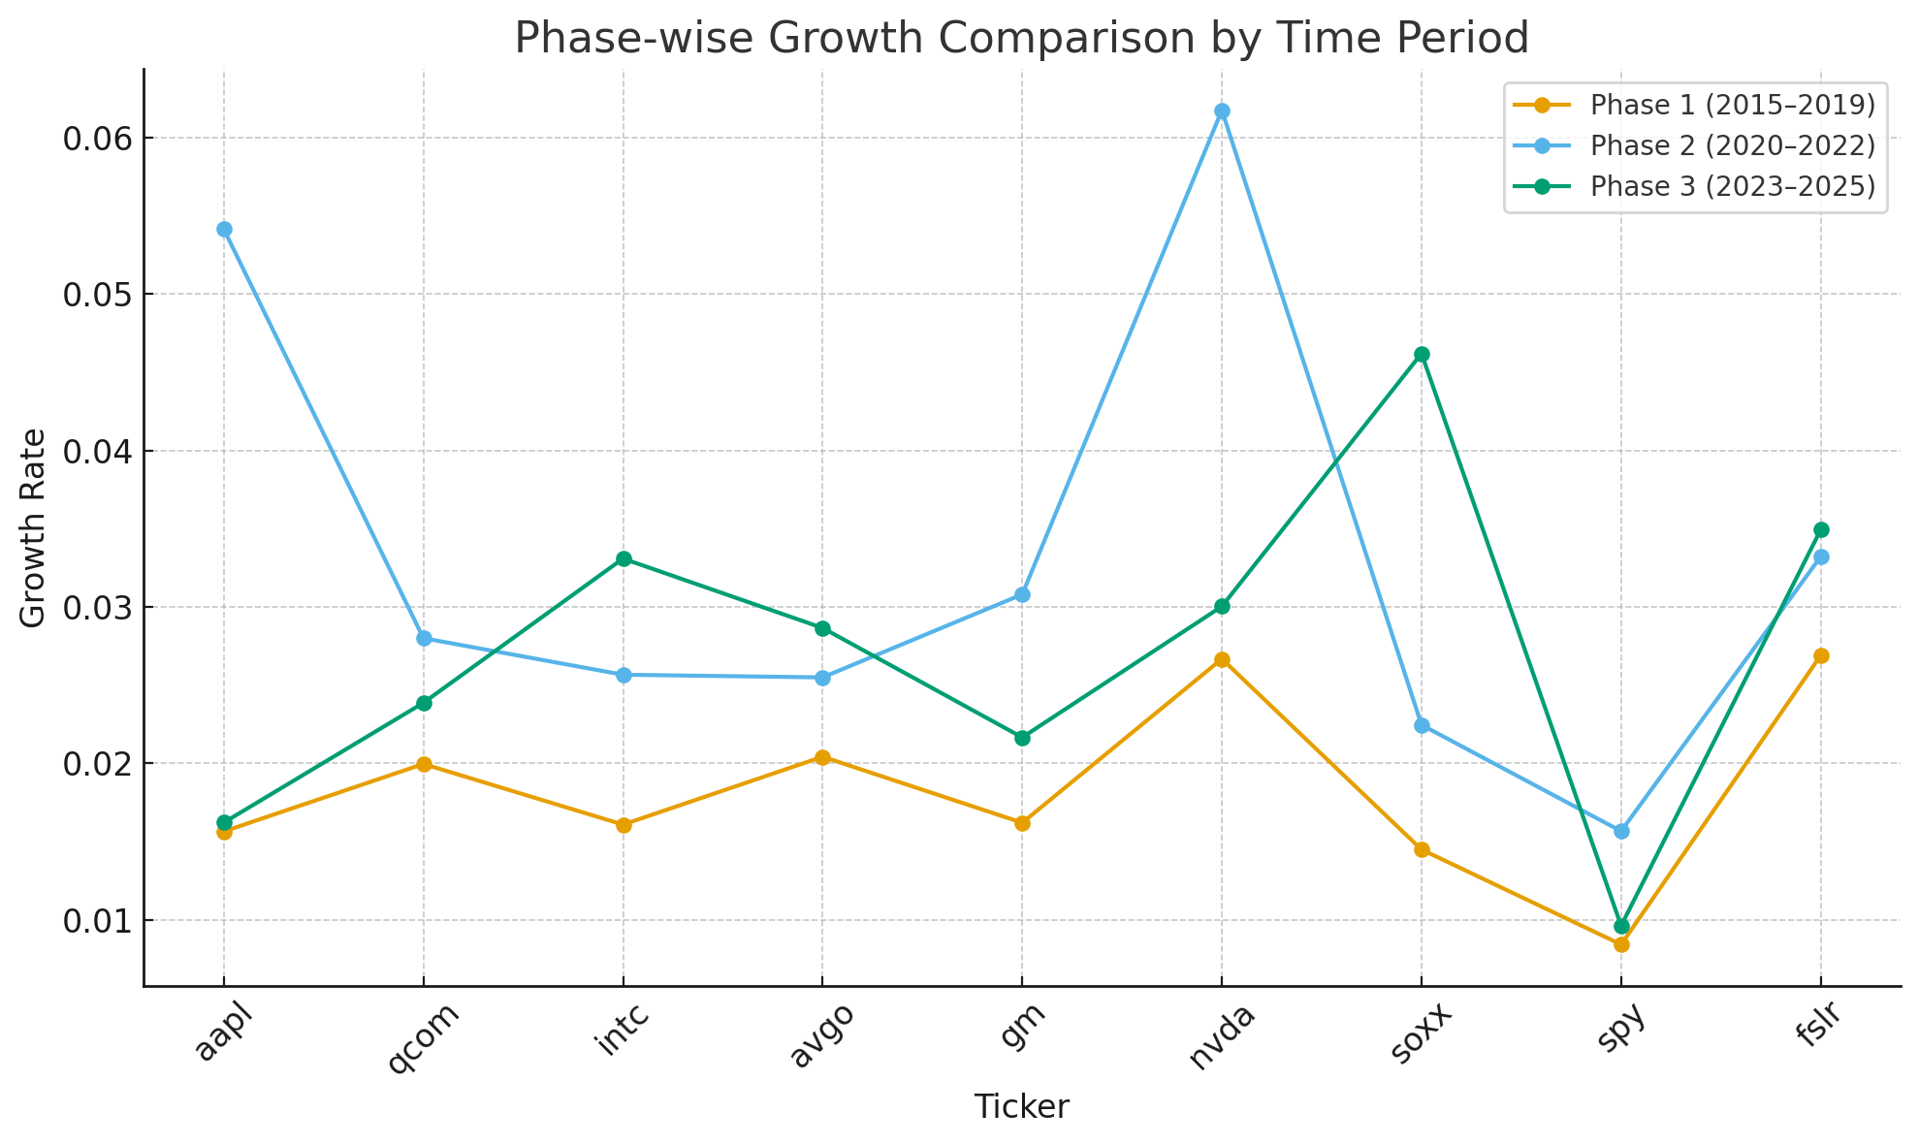
Volatility Analysis
Notes:
SOXX volatility more than tripled from Phase 1 → Phase 3.
Directly impacted sectors (AAPL, INTC, GM) saw their highest volatility during 2020–2022.
Emerging tech sectors (NVDA, QCOM, FSLR) displayed stronger spikes due to high demand and geo-politics.

Slide 14
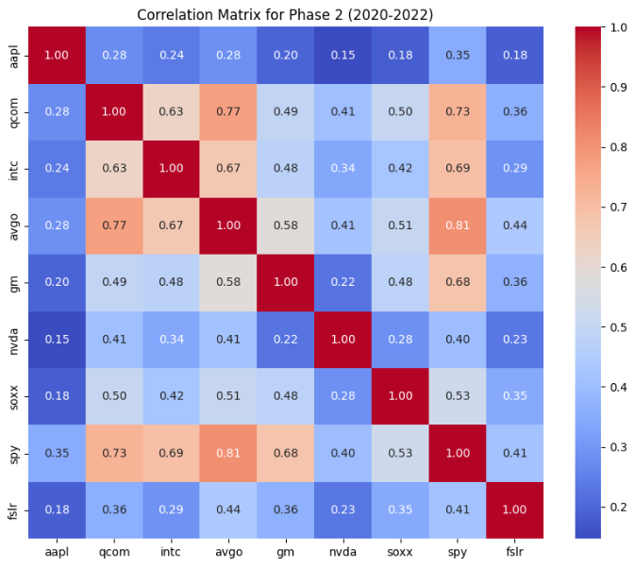
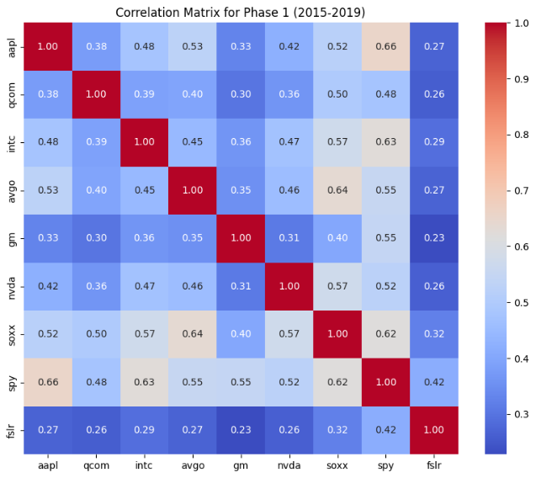
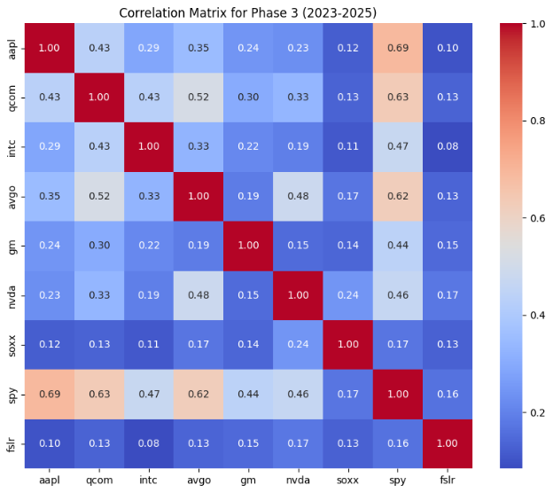
CORRELATION ANALYSIS

Slide 15
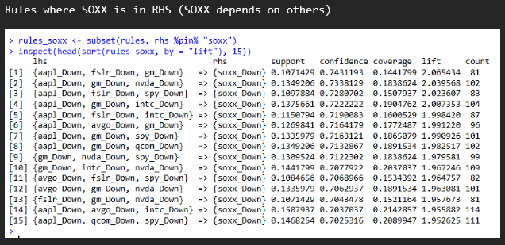
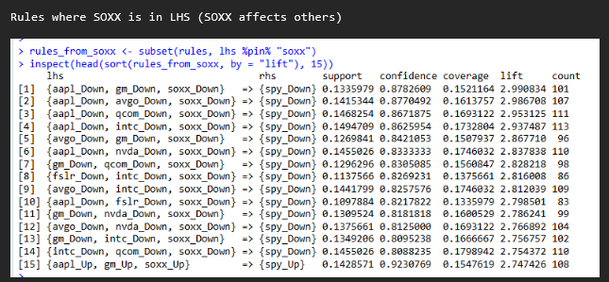
Association Mining

Slide 16
Structural Break Test (Chow Test)
Break Date | F-Statistic | p-Value | Interpretation
2020-01-01 | 4.395 | 0.0124 | Significant structural break at start of chip shortage
2023-01-01 | 0.701 | 0.4963 | No structural break; sector stabilizes
Notes:
A significant structural break appears at 2020-01-01 (F = 4.395, p = 0.0124), indicating that the relationship between semiconductor returns and the broader market changed substantially at the onset of the global chip shortage and COVID disruptions.
This confirms that Phase 2 (2020–2022) represents a distinct market regime for the semiconductor industry.
No significant break is observed at 2023-01-01 (F = 0.701, p = 0.4963), suggesting that although tariff and export-control tensions intensified after 2023, they did not fundamentally alter the SOXX–SPY return dynamics. This supports the view that the most pronounced structural impact occurred during 2020–2022 rather than in the post-shortage period.

Slide 17
Findings
Semiconductor sector was the most sensitive to supply-chain disruption, with volatility far exceeding the broader market.
Directly impacted sectors (consumer electronics, automotive, telecom) experienced pronounced performance dips during 2020–2022.
Emerging technology sectors, while not directly constrained, showed amplified volatility due to their reliance on advanced chips and global demand surges.
SOXX vs SPY comparison revealed that traditional equity markets were more resilient compared to semiconductor-focused assets.
Structural break analysis confirms 2020 was a regime-shifting event for semiconductor-linked industries.

Slide 18
Conclusion
Notes:
The semiconductor shortage fundamentally altered financial behavior across sectors from 2020 onward. Industries directly dependent on chips suffered production bottlenecks and performance declines, while emerging technology firms experienced both growth surges and heightened volatility. The broader market remained relatively stable, suggesting that supply-chain disruptions were concentrated in chip-dependent industries. Overall, the findings demonstrate that semiconductor availability plays a critical role not only in industrial output but also in shaping market behavior and investor expectations.

Slide 19
Limitations
Time Constraint: Limited ability to expand analysis to additional sectors or apply deeper econometric modeling (e.g., multivariate GARCH).
Data Storage: Polygon minute-level data required heavy filtering and could not be fully stored or processed for all potential tickers.
Company Selection: Sector representatives were limited to available tickers; some industries could not be included.
Scope of Behavioral Tests: NLP sentiment, production data, and supply-chain metrics were not integrated due to time and resource constraints.

Slide 20
Thank you

